Slide 1

Pedigree Breeders : the problem or the solution
Sean Delmar
President IKC

Slide 2
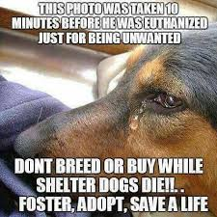
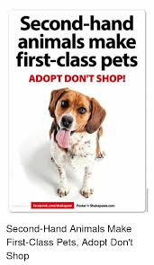
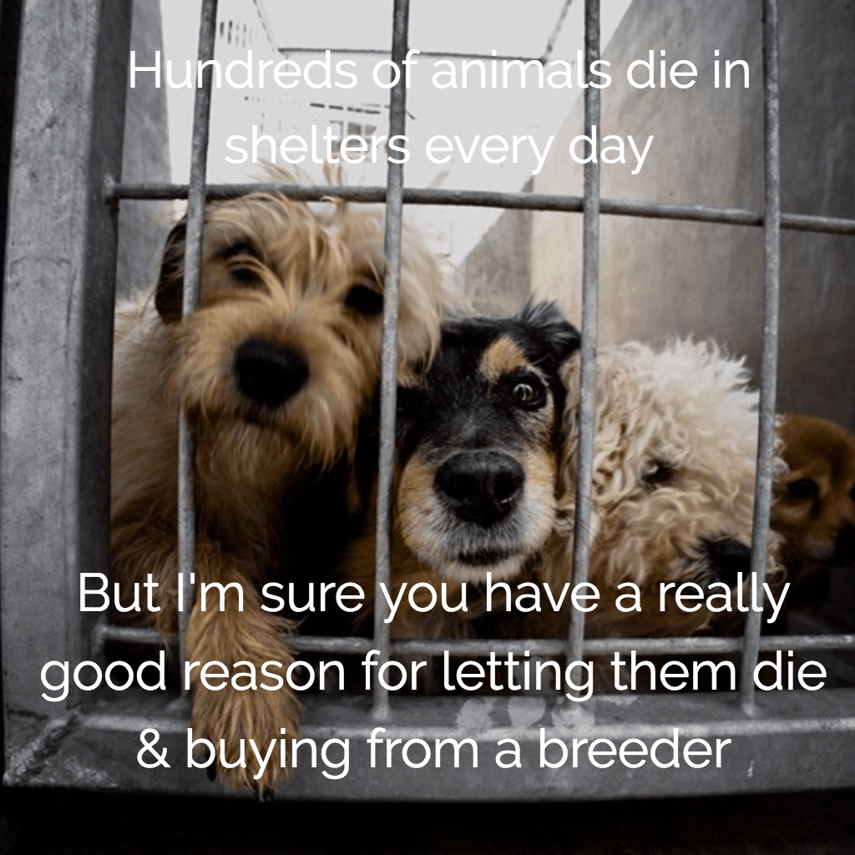
Public view of breeding

Slide 3
Pedigree Problem ?
The public only see a Dog with a problem they don’t ask if it’s a Kennel Club registered pedigree dog

Slide 4


KC breeders: visible
Easy target for
Welfare groups Legislators
On-line campaigns Tax Authorities

Slide 5
Pedigree Challenges
Myths :
Pedigree dogs are more unhealthy than non pedigree
Pedigree dogs die younger
Hybrid vigour and designer dogs give best of both breeds
Reality
Comparing size for size there is no difference between pedigree and non pedigree
Genetic and other health tests carried out by pedigree breeders
Double up on problems
Not enough Pedigree pups being bred

Slide 6
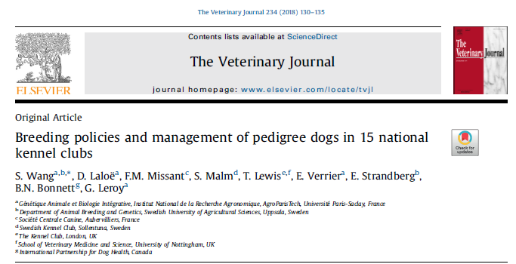

Slide 7
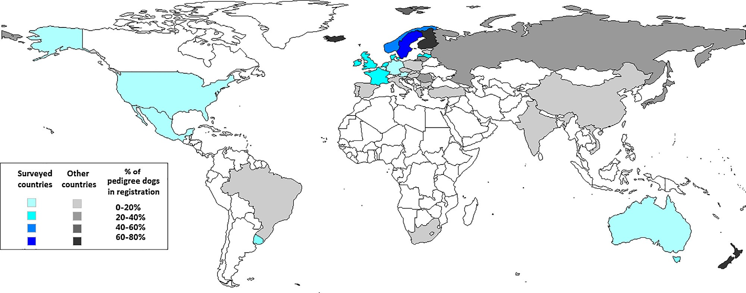
Fig. 1. Estimated percentages of pedigree dogs registered in 50 countries.

Slide 8
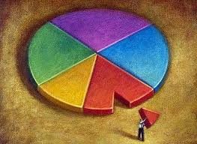
Reality: puppy sources
Worldwide Kennel Clubs account for : 20-25% of pups produced
UK 200,000 out of 900,000 pups required each year
Ireland KC 20,000 of 90,000 needed
Irish Greyhounds over produce required pups by 9000 each year
Where do the other pups come from ?
Accidental matings
Hobby breeders
Licenced Commercial enterprises
Illegal commercial farms
Smuggling

Slide 9
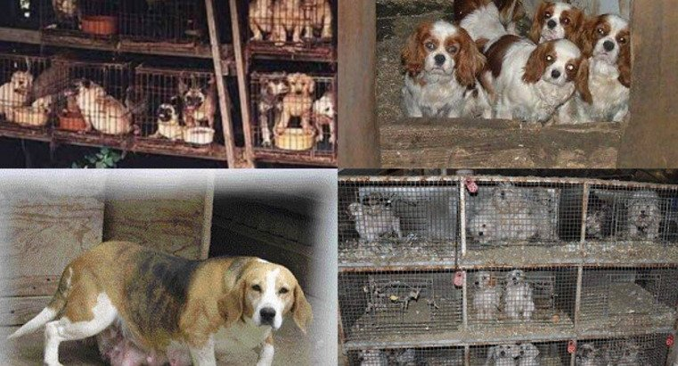
Reality of sources for a lot of pet dogs ….

Slide 10
Solutions... or more problems ?
Consequences
Actions
Encourage more pedigree breeding to make up the shortfall ?
Expect people to wait years for a puppy
Differentiate different types of breeders
Public backlash to “overbreeding”
Pedigree dogs become Premium object beyond ordinary families
Contravene codes of ethics or laws
Poor take up of Assured breeders schemes eg. UK accounts or only 3% of pups.
Help improve all dogs health and welfare whether pedigree or not , educate all breeders including commercial entities in best practices ….

Slide 11
Society
Anti dog:
Problems of segregation eg. dog parks
Dog fouling & associated health risks
Dog bites
Damage to rented property
Bans from public areas
Health & Welfare concerns
Overcrowding of shelters
Value to Society
Service Dogs :police army Customs etc
Guide & Assistance Dogs
Social Lubricant & Exercise
Loneliness & companionship
Therapy
We need to constantly remind everyone....
Golden Paws etc

Slide 12




Breed Standard
Demand: Public knowledge & attitudes
Health testing
Supply:
Breeders,
Puppy farms, Illegal imports
Judge education
Breed popularity
Breeders’ attitudes & decision making
Vets’ Role?

Slide 13

Need of further education
Judges – interpretation of breed standards and recognizing health, function and balance
Breeders
(future) owners
Veterinarians
The public
The governments
Advertising companies/media

Slide 14
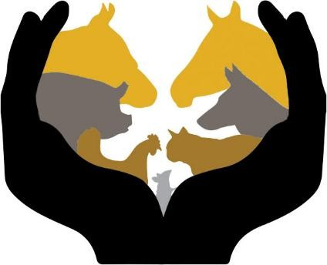
Public Perceptions of Dog Welfare, Sourcing and
Breeding Regulation
By Courtney Bir (birc@purdue.edu), Dr. Candace Croney (ccroney@purdue.edu) and Dr. Nicole Olynk Widmar (nwidmar@purdue.edu)
Published by the Center for Animal Welfare Science at Purdue University RP.2016-02 | June 2016

Slide 15
How much ability does each of the following parties have to influence and assure proper animal welfare/humane treatment practices for BREEDING dogs? Rated “very High”
Local humane societies/shelters &ASPCA &Humane Society 61% American Veterinary Medical Association (AVMA) 36% American Kennel Club (AKC) 18%
Breeders 16%
Pet buyers/purchasers 14%
Pet food companies 9%
Pet stores 7%

Slide 16
Further education
Further education all stakeholders. Changing the perception of a desired individual in pedigree breeds ...
The most desirable dog is a healthy dog with good temperament and good welfare

Slide 17
Pedigree Problem ?
Public perceptionof Hybrid vigour ?
BUT recent research (vet records of over 150,000 dogs ) from RSPCA / Royal Vet college shows no difference in health aspects between Pedigree and crossbreed/ mongrel dogs
Most cross bred dogs are only one generation from pedigree dogs.
Source of brachycephalic breeds ?
IKC registered
Puppy farmers
Hobby breeders

Slide 18
Government & Revenue
Pedigree Dogs, Value to exchequer
Vat
Licences
Purchase price
Food & equipment & Insurance
Associated incomes from employment : vets, trainers, groomers, boarding kennels, dog walkers, pharmaceuticals & Laboratories

Slide 19
Germany Dog Ownership :
Approximately 6.9 million dogs in Germany (2013)
Turnover: €4.6 Billion
Employment : approx. 95k to 100,000 jobs

Slide 20
Health & Welfare Issues
Our mission is to advance the health, breeding and sport of purebred dogs and promote responsible dog ownership.
IKC mission statement
Extremes of Conformation
Dermatitis
Eye problems
Obstructed air ways
Breathing difficulties eg. Snoring
Heat exhaustion
Exercise
Nasal folds
Shortened Muzzle

Slide 21
Lack of knowledge/ understanding
The extent of suffering related to the brachycephalic constitution is still not really realized among breeders/(future) owners
  Think their dogs have good function – do not recognize symptoms/suffering.
  Regard symptoms as breed-specific characteristics (even
Desirable!!)
  Classified as “normal for the breed”
    1) failure to exclude sick dogs from breeding
    2) failure to give sick dogs the treatment they need
    3) failure to reduce the desirability of these breeds

Slide 22


Golden Rules
There should be no action without evidence
There can be no evidence without data

Slide 23
What do we do with the results ?
Record on database for everyone to access
Allow results on pedigree and IKC website
Voluntary disclosure and eventually mandatory
Over what period of time to implement full scheme.
Eventually limit breeding to those dogs
successfully tested
    Limit breeding to those dogs successfully tested

Slide 24
Partnerships with academics
& institutions
We have the data ...they have the resources of students for statistical analysis
Legislators want evidence
We want evidence based decisions

Slide 25
Role of Judges
Interpretation of breed standards
Requirement for health education as part of judges education modules ?
Do you want judges to be mini-vets ?
Will breed standards have a trickle down effect on change ? How long will it take to change?
Will it limit genetic diversity ?

Slide 26
Veterinary Professionals
Can view KC members as opponents creating ill health in dogs by bad breeding.
Do not differentiate between registered and non registered pedigree dogs or source of dogs
Only see ill and unhealthy dogs so view can be distorted .
Aspirational aims rather than practical help
Most see clients after purchase when it may be too late
Need for further education on specific welfare issues

Slide 27
Owner attitude : Cuteness
RESEARCH ARTICLE
Why do people buy dogs with potential
welfare problems related to extreme
conformation and inherited disease? A
representative study of Danish owners of four small dog breeds
P. Sandøe1,2*, S. V. Kondrup1, P. C. Bennett3, B. Forkman2, I Meyer2, H. F. Proschowsky4, J. A. Serpell5, T. B. Lund1
“There were clear differences between owners of the four breeds with respect to degree of planning prior to purchase, with owners of Chihuahuas exhibiting less.
Motivations behind choice of dog were also different. Health and other breed attributes were more important to owners of Cairn Terriers, whereas the dog's personality was reported to be more important for owners of French Bulldogs and Cavalier King Charles Spaniels but less important for Chihuahua owners.”

Slide 28
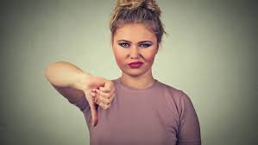

How to change attitudes

Slide 29

KC role
Reactive.... or proactive ?

Slide 30
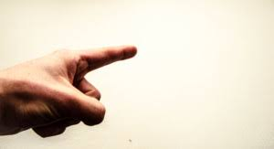
Need to stop blaming ….

Slide 31
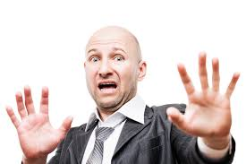
Defensive
Defensive behaviour is the primary barrier to communication…no one listens

Slide 32
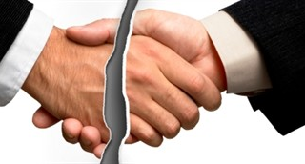
Repair or develop alliances

Slide 33
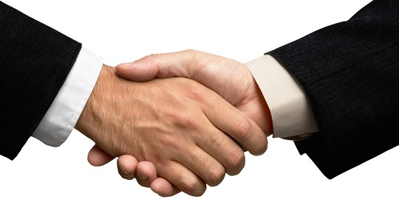
Co-operate
with all stakeholders

Slide 34
Failures to change …
Giving information is not enough
Different presentation methods required
People learn by different methods
Emotional messages /learning interferes with logical thought
People / groups learn at different rates and start from different positions.
Realisation we must use techniques from behavioural science
(observation, practical, reading, listening etc)

Slide 35
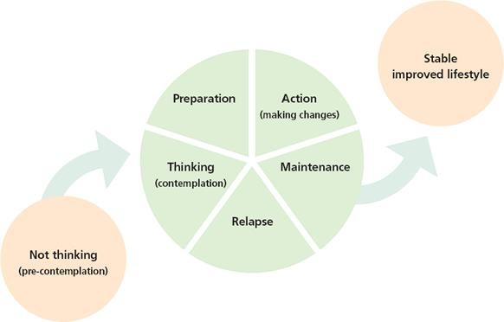
Human Behaviour Change Model : CONTEXT
We have not been effective in
attempts to ‘educate’.
It is not just about transferring information and knowledge.
Better Health and Welfare
We need to impact Human Behaviour Change.

Slide 36

Stages of Change Model : CONTEXT
Pre-contemplation: There’s nothing wrong with my dog / this breed / the way we are breeding these dogs…
Resistance?
- Ignorance / lack of evidence?
- Deep personal investment, extreme
consequences of accepting responsibility?
Better Health and Welfare
And/or
- Problem is so complex … any hope of resolution seems impossible.
e.g. snoring or fainting ‘Normal’
‘OK’
‘Charming’

Slide 37
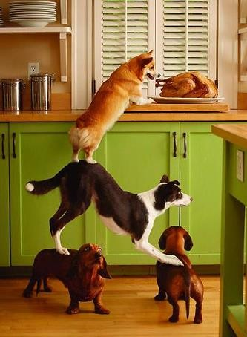




Slide 38
Investigation
Consultation
Communication
Co-operation
Education
Show leadership,
or others will

Slide 39

A rising tide lifts all boats
Thank you

